Slide 2
Getting started with Git and GitHub
Introduction to source control
Introduction to Git and Github
Cloning a repository
Viewing repo history
Making changes
Create a repository
Setting up Git
Git config
Branching and merging

Slide 3
Source Control
Keep track of changes made to code
Work collaboratively on code with others
Roll back changes if necessary
Test new features without affecting the main codebase
Ensure that everyone is working on the same version of code

Slide 4
git
Git is a distributed version control system that tracks changes in any set of computer files.
It was originally developed in 2005 by Linus Torvalds, the creator of the Linux operating system kernel.
A staggering number of software projects rely on Git for version control, including commercial projects as well as open source.
CLI tool

Slide 5
Github.com
GitHub is a web-based platform that uses Git for version control.
It was launched in 2008 and has since become one of the largest code hosting platforms in the world.
GitHub allows developers to collaborate on projects, track changes to code, and host their code repositories online.

Slide 6
Exploring Github
https://github.com/devops-collective-inc
https://github.com/PowerShell
https://github.com/KevinMarquette

Slide 7
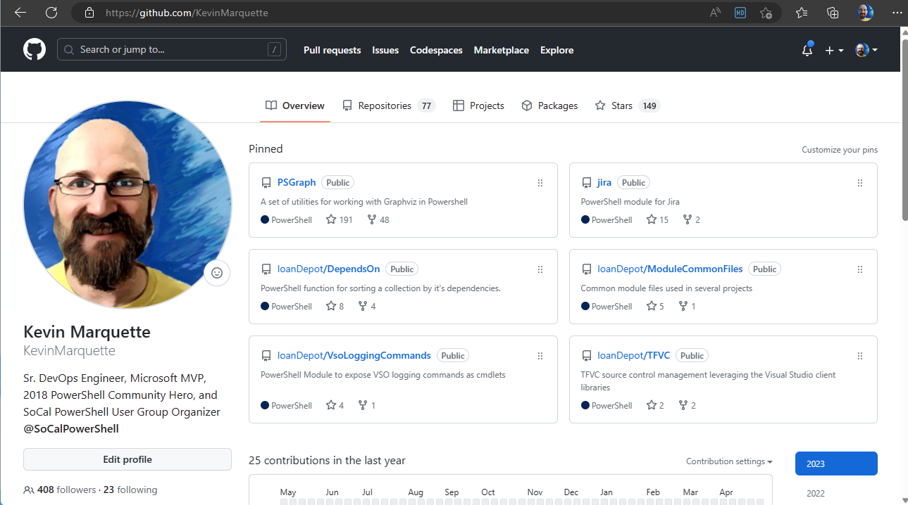

Slide 8
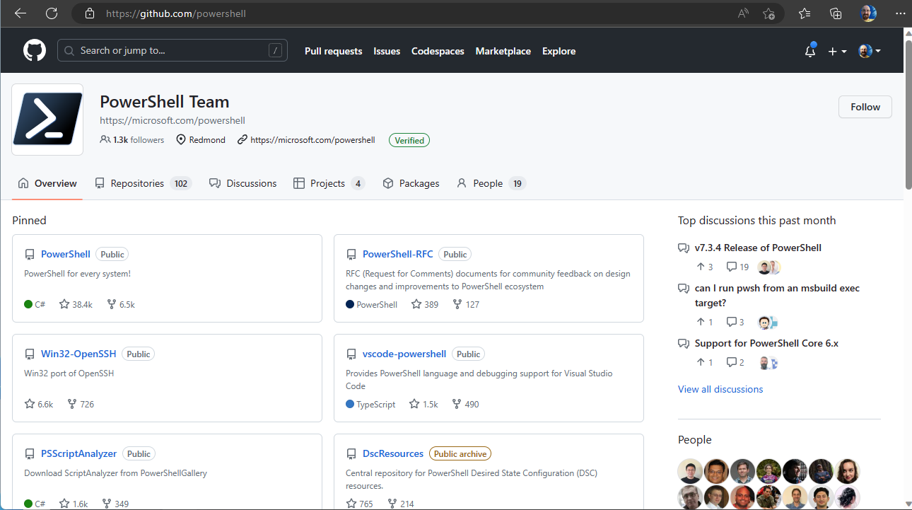

Slide 9
Github: clone
Downloading remote repository files

Slide 10
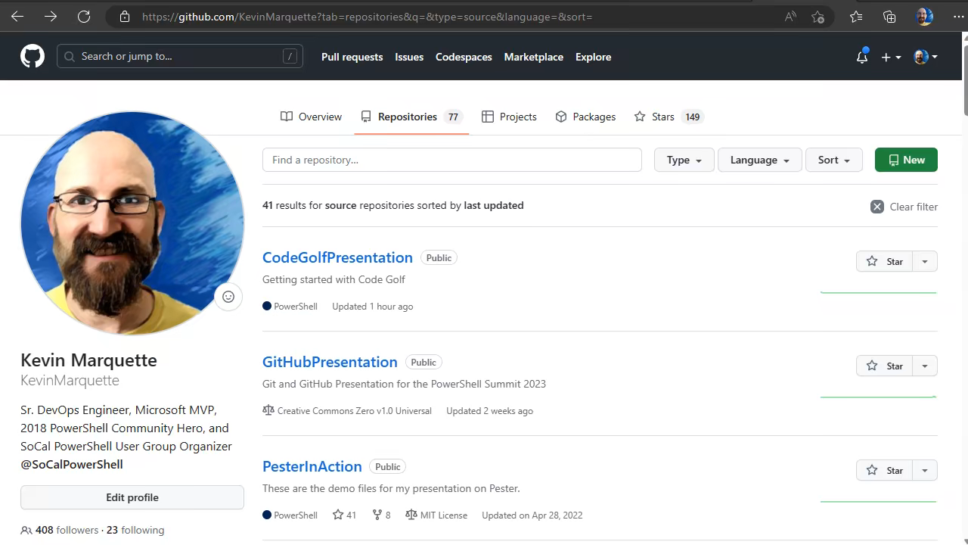

Slide 11
Github: Commit History
Viewing changes

Slide 12
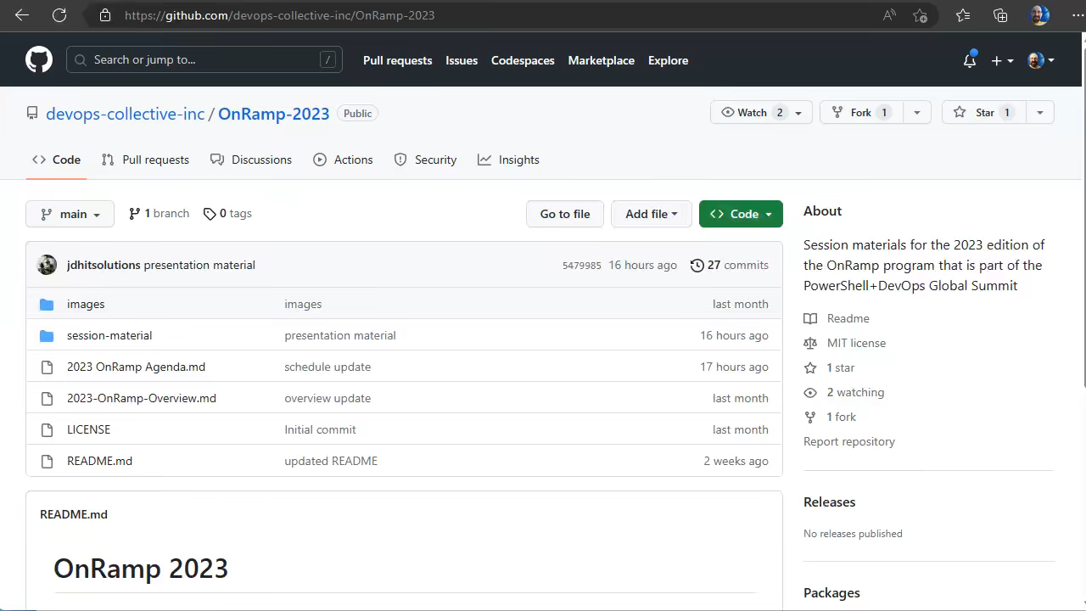

Slide 13
Github: Commit
Making changes

Slide 14
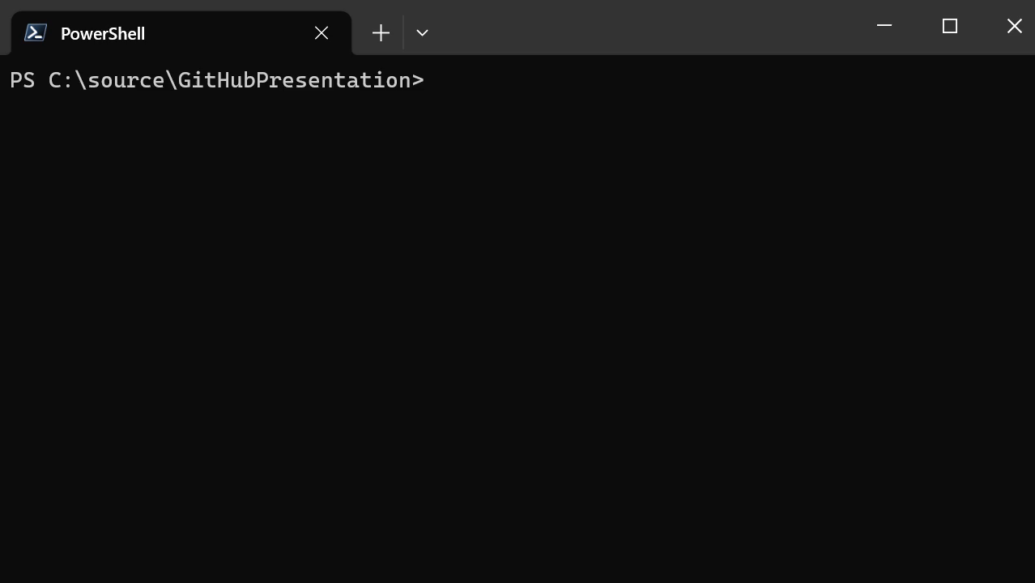

Slide 15
Create and Clone Repo

Slide 16
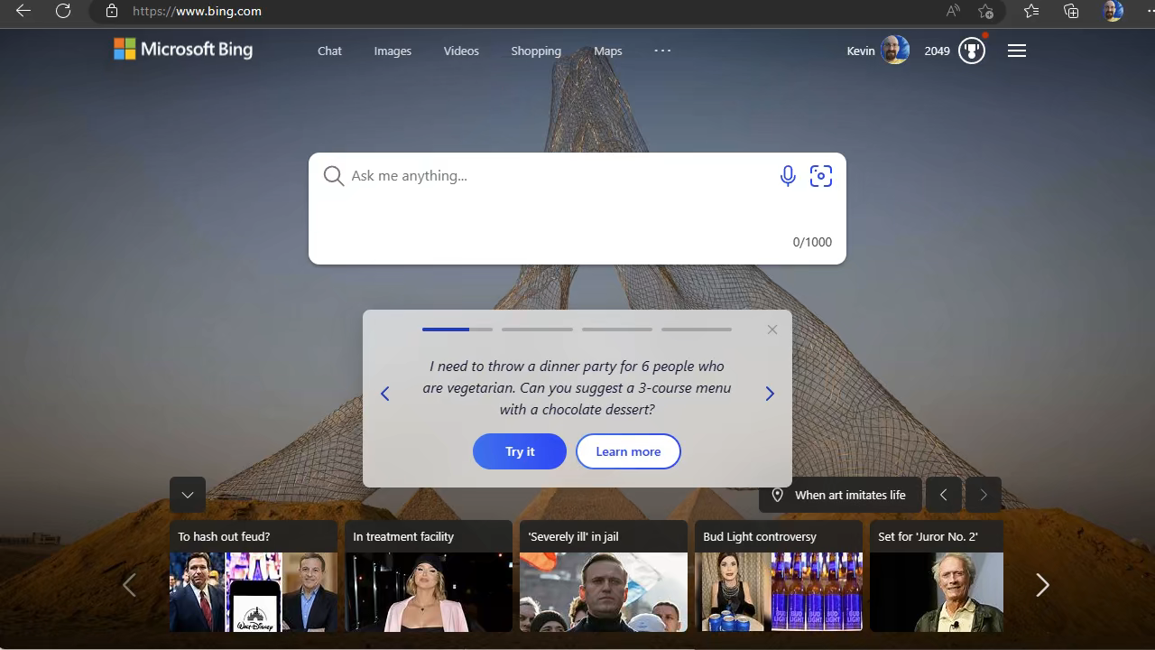

Slide 17
Installing Git
Installing git

Slide 18
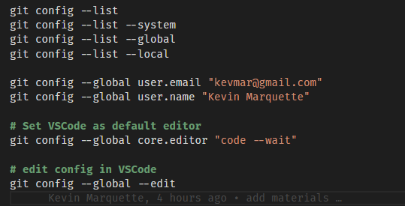
Git config

Slide 19

Git config

Slide 20
Branching and Merging

Slide 21
